Slide 1
Graphic Tablet

Slide 2
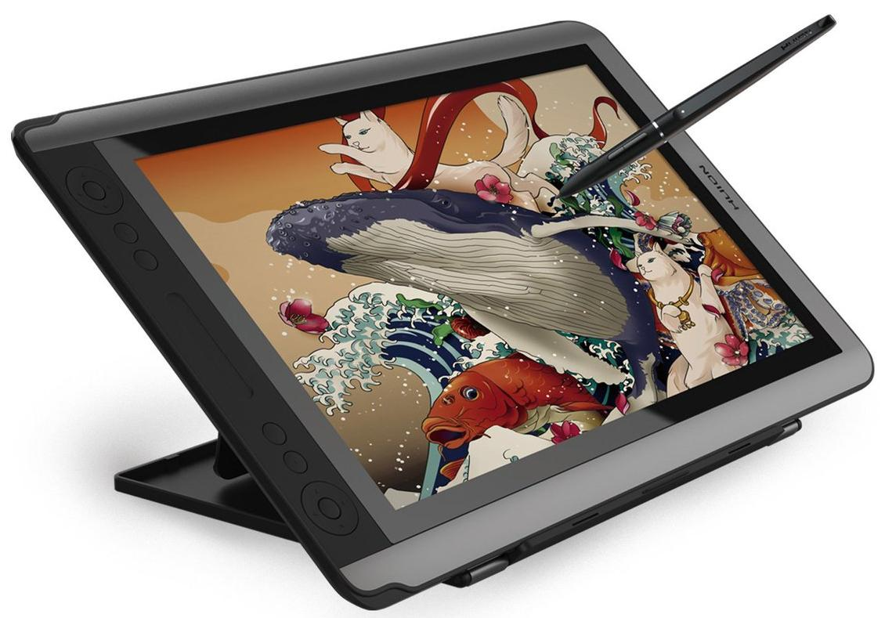
A graphics tablet is a device for entering information created by hand directly into a computer.

Slide 3
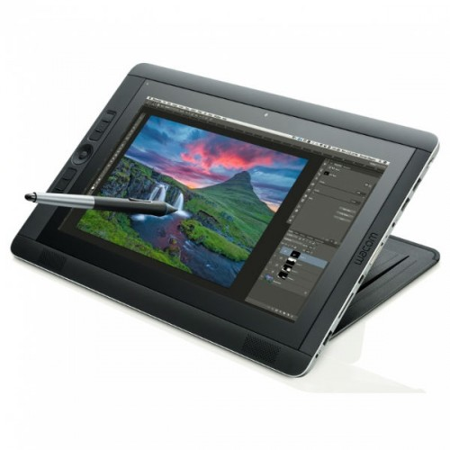
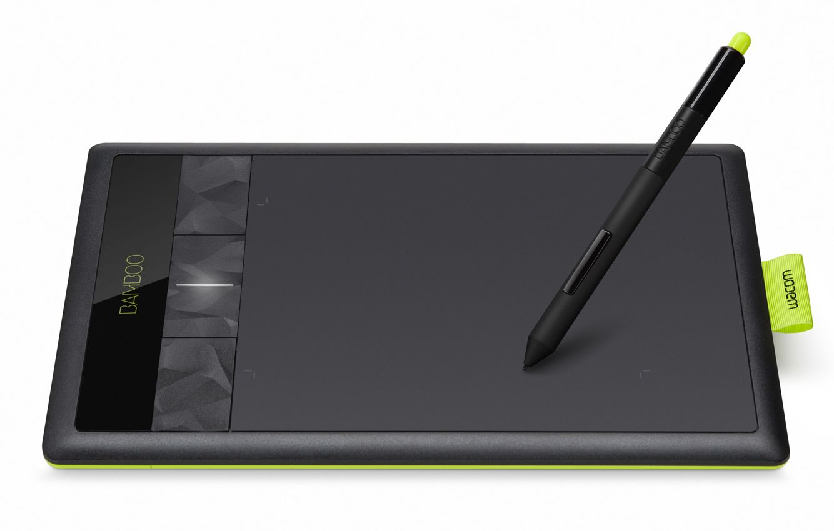
Types of graphic tablets

Slide 4
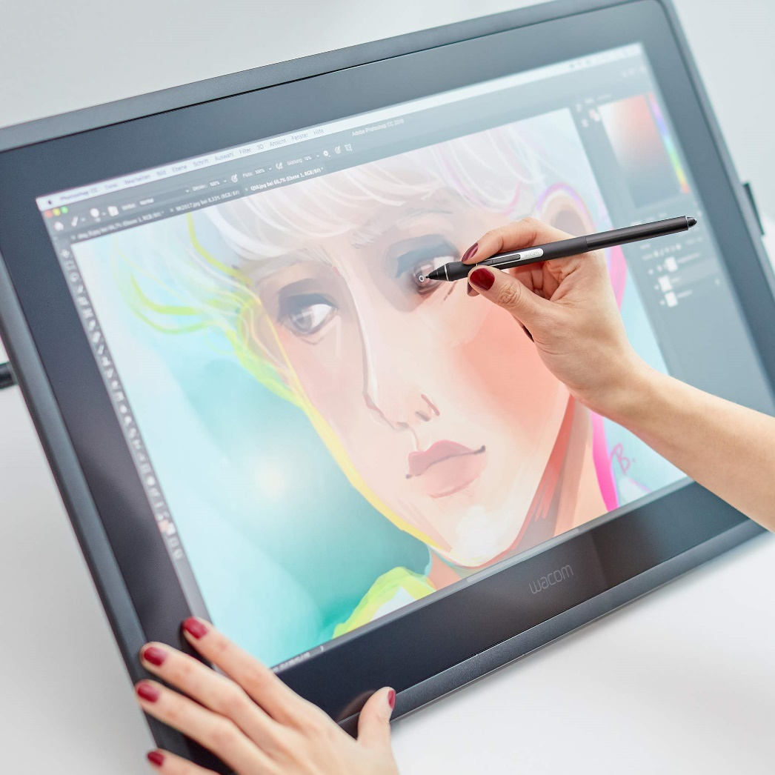
Specifications

Slide 5
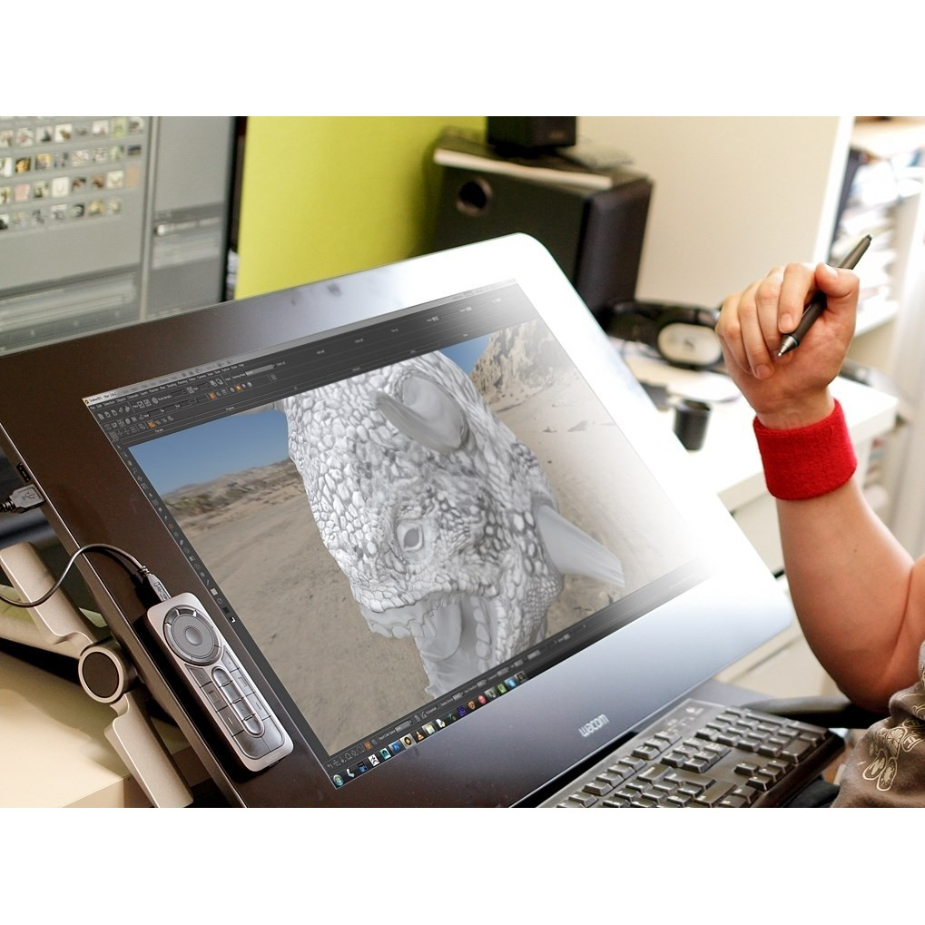
Application

Slide 6
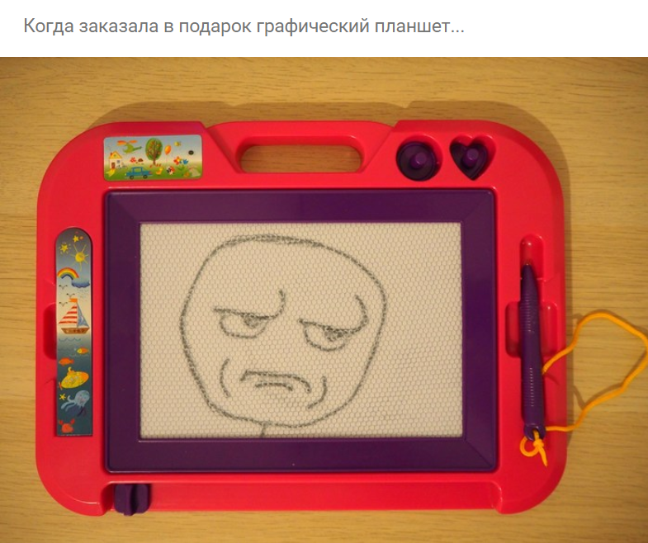
The ending Everyone can afford this tablet ;)

